Slide 1

ZigBee
COMPILED BY :- ASST. PROF. RASHMI M. POTE

Slide 2
Content
Introduction
History
ZigBee Alliance
Characteristics
Security
Applications
ZigBee/IEEE 802.15.4
IEEE 802.15.4 Physical Layer
IEEE 802.15.4 MAC Layer
ZigBee Network Topologies
ZigBee and Bluetooth Comparison

Slide 3
Introduction
ZigBee is a technological standard designed for control and sensor networks
Based on the IEEE 802.15.4 Standard
Created by the ZigBee Alliance

Slide 4
Introduction
Operates in Personal Area Networks (PAN’s) and device-to-device networks
Connectivity between small packet devices
Control of lights, switches, thermostats, appliances, etc.
Notes:
Thermostats---→自動恆溫器

Slide 5
History
Development started 1998, when many engineers realized that WiFi and Bluetooth were going to be unsuitable for many applications
IEEE 802.15.4 standard was completed in May 2003

Slide 6

ZigBee Alliance
Organization defining global standards for reliable, cost‐effective, low power wireless applications
A consortium of end users and solution providers, primarily responsible for the development of the 802.15.4 standard
Developing applications and network capability utilizing the 802.15.4 packet delivery mechanism
Notes:
ZigBee聯盟 (ZigBee Alliance) 是由多家公司組成的産業組織，主要目標是實現以開放性全球標準爲基礎、工作可靠、低成本、低功耗、無線網路連接的監測和控制産品。

Slide 7
Characteristics
Low cost
Low power consumption
Low data rate
Relatively short transmission range
Scalability
Reliability
Flexible protocol design suitable for many applications
Notes:
省電：ZigBee傳輸速率低，使其傳輸資料量亦少，所以訊號的收發時間短，其次在非工作模式時，ZigBee處於睡眠模式，而在工作與睡眠模式之間的轉換時間，一般睡眠啟動時間只有15ms，而設備搜索時間為30ms。透過上述方式，使得ZigBee十分省電，透過電池則可支援ZigBee長達6個月到2年左右的使用時間。
可靠度高：ZigBee之MAC層採用talk-when-ready之碰撞避免機制，此機制為當有資料傳送需求時則立即傳送，每個發送的資料封包都由接收方確認收到，並進行確認訊息回覆，若沒有得到確認訊息的回覆就表示發生了碰撞，將再傳一次，以此方式大幅提高系統資訊傳輸之可靠度。
高度擴充性：一個ZigBee的網路最多包括有255個ZigBee網路節點，其中一個是Master設備，其餘則是Slave設備。若是透過Network Coordinator則整體網路最多可達到6500個ZigBee網路節點，再加上各個Network Coordinator可互相連接，整體ZigBee網路節點數目將十分可觀。

Slide 8
Security
Encryption specified for MAC, Network and APS layers
Encryprion/Authentication mode CCM(CTR +CBC-MAC)
CTR is a counter based encryption mode
CBC-MAC provides data integrity
All security is based on 128bit key and AES-128 block encryption method
Notes:
APS Layers---→Application support sub-layer (APS sub-layer is between NWK layer and Application Layer, and it provides an interface through service)
CTR---→Counter (CTR mode is also known as Integer Counter Mode and Segmented Integer Counter)
CBC-MAC---→Cipher Block Chaining Message Authentication Code

Slide 9






Applications
monitors
sensors
automation
control
INDUSTRIAL & COMMERCIAL
CONSUMER ELECTRONICS
TV VCR
DVD/CD
Remote control
PERSONAL HEALTH CARE
ZigBee
LOW DATA-RATE
RADIO DEVICES
PC & PERIPHERALS
mouse
keyboard
joystick
monitors
diagnostics
sensors
consoles portables
educational
TOYS &
GAMES
HOME AUTOMATION
security
HVAC
lighting
closures
Notes:
HVAC---→Heating, ventilating, and air conditioning (供暖,通風,空調)
ZigBee目前的應用有：
1. 工商業的自動控制系統
2. 個人健康診斷
3. 攜帶型娛樂工具
4. 家庭消費電子設備遠距控制
5. 個人電腦的周邊無線控制
6. 居家安全與自動監控

Slide 10
Let’s Watch a Video
Introduction to Zigbee (2020) | Learn Technology in 5 Minutes
https://www.youtube.com/watch?v=QXV_HgGO--g

Slide 11
ZigBee/IEEE 802.15.4
Application
Customer
ZigBee Alliance
-“the software”
-Network, Security & Application layers
-Brand management
IEEE 802.15.4
-“the hardware”
-Physical & Media Access Control layers
API
Security
32- / 64- / 128-bit encryption
ZigBee
Alliance
Network
Star / Mesh / Cluster-Tree
MAC
IEEE
802.15.4
PHY
868MHz / 915MHz / 2.4GHz
Notes:
ZigBee標準主要是IEEE 802.15.4與ZigBee Alliance這二個組織，分別制定硬體與軟體標準。
在實體層(PHY)、媒體儲存控制層(MAC)、資料鏈結層(Data Link)等發展由IEEE主導，而ZigBee Alliance負責制定邏輯網路、資料傳輸加密機制、應用介面規範及各系統產品之間互通規範。

Slide 12
IEEE 802.15.4 Architecture
ZigBee Application Framework
Networking App Layer
Data Link Controller (DLC)
IEEE 802.2 LLC
Other LLC
IEEE 802.15.4 MAC
IEEE 802.15.4
868/915 MHz
PHY
IEEE 802.15.4
2400 MHz
PHY

Slide 13
IEEE 802.15.4 Physical Layer
PHY functionalities:
Activation and deactivation of the radio transceiver
Energy detection within the current channel
Link quality indication for received packets
Clear channel assessment for CSMA-CA
Channel frequency selection
Data transmission and reception
Notes:
ZigBee的實體層負責啟動和停止無線電收發器、選擇通道、能量偵測以及封包的傳送和接收等功能。
CSMA-CA---→Carrier Sense Multiple Access-Collision Avoidance
實體層的功能：
1. 無線電收發的啟用與關閉
2. 從當前的channel做能源的偵測
3. 從接收到的封包當成鏈結品質指標
4. 利用CSMA-CA來評估可使用的channel
5. Channel頻率的選擇
6. 資料傳送與接收

Slide 14
PHY frame structure
PHY packet fields
Preamble (32 bits) – synchronization
Start of packet delimiter (8 bits) – shall be formatted as “11100101”
PHY header (8 bits) –PSDU length
PSDU (0 to 127 bytes) – data field
Sync Header
PHY Header
PHY Payload
Start of
Packet
Delimiter
Frame
Length
(7 bit)
Preamble
Reserve
(1 bit)
PHY Service
Data Unit (PSDU)
4 Octets
1 Octets
1 Octets
0-127 Bytes
Notes:
實體層資料傳輸封包格式
1. 前置位元(32bits) – 同步化時間
2. 封包定義起始(8bits) – 直接以11100101表示
3. 實體層標頭(8bits) – 表示PSDU的長度
4. PSDU(0 ~ 1016bits) – 資料欄位

Slide 15
Operating frequency bands
The standard specifies two PHYs :
868 MHz/915 MHz direct sequence spread spectrum (DSSS) PHY (11 channels)
1 channel (20Kb/s) in European 868MHz band
10 channels (40Kb/s) in 915 (902-928)MHz ISM band
868MHz/
915MHz
PHY
Channel 0
Channels 1-10
2 MHz
868.3 MHz
902 MHz
928 MHz
Notes:
ZigBee主要可使用的頻段有三個，分別是2.4GHz的ISM頻段、915MHz頻段以及868MHz頻段，而不同頻段可使用的通道分別是16、10、1個。
ZigBee的傳輸速率介於20kbps - 250kbps之間，依使用頻段不同而有所差異，並隨著傳輸距離的延長而減慢，不過借著提高發射功率，還是可以提高傳輸速率。

Slide 16
Operating frequency bands
2450 MHz direct sequence spread spectrum (DSSS) PHY (16 channels)
16 channels (250Kb/s) in 2.4GHz band
2.4 GHz
PHY
Channels 11-26
5 MHz
2.4 GHz
2.4835 GHz

Slide 17
IEEE 802.15.4 MAC Layer
Traffic Type
Periodic data
e.g. sensors
Intermittent data
e.g. light switch
Repetitive low latency data
e.g. mouse
Notes:
ZigBee 的媒體存取控制層提供MAC資訊服務和管理服務，負責信標(beacon)管理、通道接取、保障時槽(guaranteed time slots, GTS)管理、訊框驗證、回覆訊框之傳輸及加盟(association)與終止加盟(disassociation)
Traffic Type
第一種：定時會傳輸資料的裝置，例如：感測器。
第二種：不定時會傳輸資料的裝置，例如：照明裝置，當人走過照明裝置，燈光亮起來的時候，照明裝置會傳輸資料，像是說有人經過。
第三種：需迅速送資料到達其他設備的裝置，例如：滑鼠，當在使用滑鼠時，滑鼠的訊號需要迅速送到電腦。
Intermittent-→間歇的，斷斷續續的
Periodic ---→週期性的
Repetitive--→重複的

Slide 18
IEEE 802.15.4 MAC Layer
Device Classes
Full function device (FFD)
Can function in any topology
Capable of being Network coordinator
Can talk to any other device (FFD/RFD)
Reduced function device (RFD)
Limited to star topology
Cannot become network coordinator
Talks only to FFDs
Address
All devices must have 64 bit IEEE addresses
Short (16 bit) addresses can be allocated to reduce packet size
Notes:
ZigBee的設備有兩種，一種是完整功能裝置(FFD)，另一種是精簡功能裝置(RFD)，
FFD可以用在ZigBee任何的網路拓墣，並且可以做為網路協調者，網路協調者就是負責建立網路、管理網路的裝置，並且可以和FFD和RFD溝通。
RFD只能用在星狀拓墣中，並且只能和FFD溝通。ZigBee的MAC位址有兩種格式，包括用在大型網路的64位元位址，以及16位元的短位址，適合用在較小型的網路
ZigBee的MAC位址有兩種格式，包括用在大型網路的64位元位址，以及16位元的短位址，適合用在較小型的網路。

Slide 19
IEEE 802.15.4 MAC Layer
Frame Types
Data Frame
used for all transfers of data
Beacon Frame
used by a coordinator to transmit beacons
Acknowledgment Frame
used for confirming successful frame reception
MAC Command Frame
used for handling all MAC peer entity control transfers
Notes:
ZigBee的frame種類有四種：
Data frame是用來傳輸資料
Beacon是用來做同步化，Beacon的功能是啟動superframe，將其他裝置同步，告訴不在這個網路裏的裝置這個有我這個coordinator形成的PAN，以及告訴裝置有資料要傳輸給他
Acknowledgment frame
Mac command frame則是用來下些指令，例如data request

Slide 20
IEEE 802.15.4 MAC Layer
Transmission Mode
Slotted (Beacon enable mode )
Periodic data and Repetitive low latency data using.
Un-slotted (Non-Beacon enable mode)
Intermittent data using.
Notes:
ZigBee的傳輸模式
ZigBee的傳輸模式有兩種，一種是Slotted另一種是unslotted，Slotted是指coordinator會訂時發出beacon來做同步化的動作，適合用來傳輸定時
性的資料和需要低延遲的資料
Unslotted則是指裝置要傳輸資料的話都靠csma/ca來搶頻寬傳輸資料，適合用來傳不定時的資料
而device要傳資料給coordinator則是在slotted情況下，當coordinator發出beacon後，device如果有資料要傳輸資料的話，就將資料傳給coordinator
而在unslotted模式下，device用csma/ca搶頻寬，在將資料傳給coordinator

Slide 21
ZigBee Network Topologies
Mesh
Star
Cluster Tree
PAN coordinator
Full Function Device
Reduced Function Device
Notes:
ZigBee網路層方面，ZigBee支援Star、Cluster Tree與Mesh三種網路架構，在各個節點之角色方面，可分為全功能設備（Full-Function Device；FFD）與精簡功能設備（Reduced-Function Device；RFD）。相較於FFD，RFD之電路較為簡單且記憶體較小。FFD之節點具備控制器（Controller）之功能提供資料交換，而RFD則是只能傳送資料給予FFD或是從FFD接受資料。
在星狀和樹狀網路中，coordinator會定時地發出beacon來同步化網路中其他裝置。

Slide 22
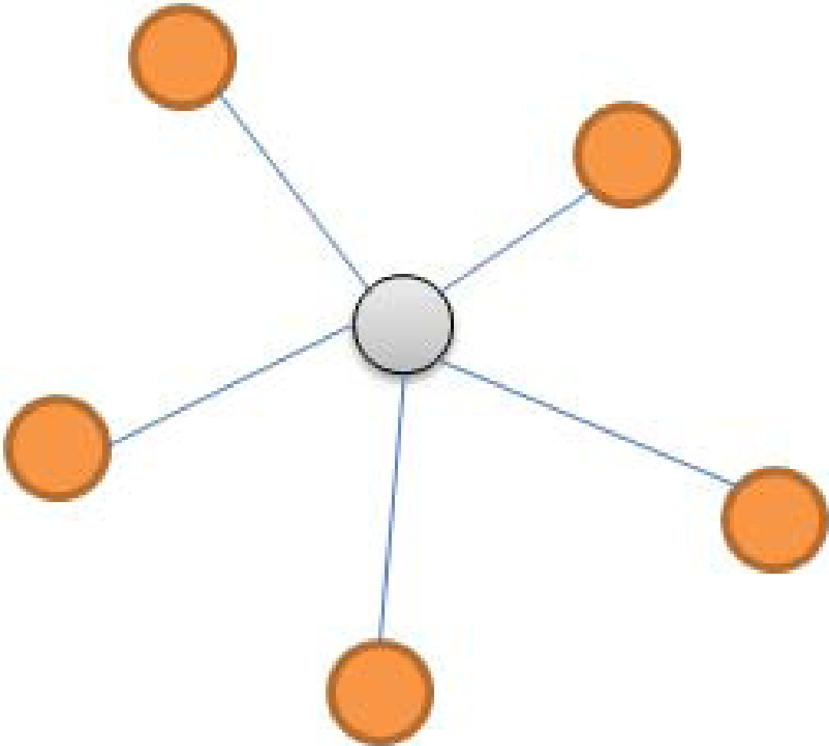
ZigBee Network Topologies
Star Topology
Advantage
Easy to synchronize
Low latency
Disadvantage
Small scale
Notes:
星狀拓樸，他的優點是容易同步化和所以有superframe，低延遲缺點是難以擴充

Slide 23
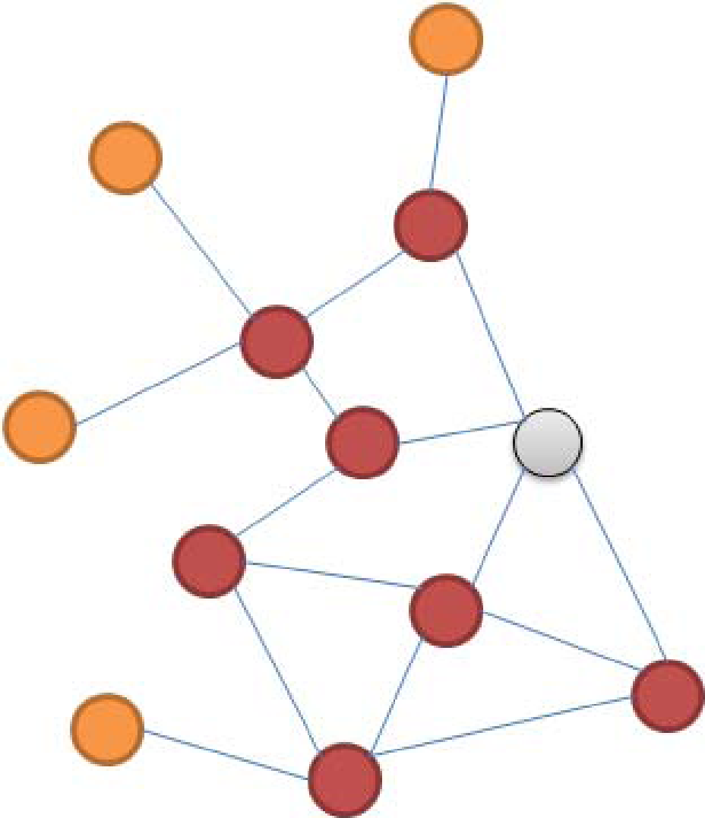
ZigBee Network Topologies
Mesh Topology
Advantage
Robust multihop communication
Network is more flexible
Lower latency
Disadvantage
Route discovery is costly
Needs storage for routing table
Notes:
Mesh優點是允許多點傳播、網路形成較具彈性和低延遲
網路拓墣，優點是允許多點傳播、網路形成較具彈性和低延遲 缺點是不具有superframe，route discovery成本過大和須另有儲存空間儲存路由表

Slide 24
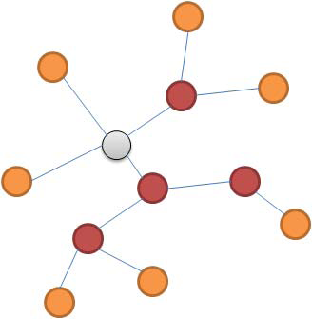
ZigBee Network Topologies
Cluster Tree
Advantage
Low routing cost
Allow multihop communication
Disadvantage
Route reconstruction is costly
Latency may be quite long
Notes:
樹狀拓樸的優點是低路由成本和可以有superframe，允許多點傳播
缺點是路由重建是成本耗費過大和延遲過長

Slide 25
ZigBee and Bluetooth Comparison
Optimized for different applications
ZigBee
Smaller packets over large network
Mostly Static networks with many, infrequently used devices
Home automation, toys, remote controls, etc.
Bluetooth
Larger packets over small network
Ad‐hoc networks
File transfer
Screen graphics, pictures, handsfree audio, Mobile phones, headsets, PDAs, etc.

Slide 26
ZigBee and Bluetooth Comparison
Feature(s) | Bluetooth | ZigBee
Power Profile | Days | Years
Complexity | Complex | Simple
Nodes/Master | 7 | 64000
Latency | 10 seconds | 30 ms – 1s
Range | 10m | 70m ~ 300m
Extendibility | No | Yes
Data Rate | 1 Mbps | 250 Kbps
Security | 64bit, 128bit | 128bit AES and Application Layer
Notes:
Zigbee是一種短距離的通訊技術，理想中的傳輸距離是300公尺，實際距離約150~200公尺，資料傳輸速率從20Kbps到250Kbps，而且會隨著距離的增長而不同，為藍芽的傳輸速率是1Mbps,適合比較複雜的應用，而ZigBee的應用定位主要是在一般的資料擷取，例如環境監測、家電自動化控制、個人醫療、工業廠房監控、商務大樓自動化、保全監控...等
ZigBee其節點數可多達六萬多點，距離也因為採用Mesh架構(每個節點可以擷取資料也可傳遞來自其他節點的資料)較不受限制，因此ZigBee具有最省電、最大網路節點數及最低成本等優點，專為低成本多節點的低功耗網路所設計

Slide 27
ZigBee and Bluetooth Comparison
TEXT
GRAPHICS
INTERNET
HI-FI
AUDIO
STREAMING
VIDEO
DIGITAL
VIDEO
MULTI-CHANNEL
VIDEO
802.15.4
ZigBee
802.11b
LAN
802.11a/HL2 & 802.11g
SHORT < RANGE > LONG
802.15.1
Bluetooth 2
PAN
802.15.1
Bluetooth1
LOW < DATA RATE > HIGH

Slide 28
Your best quote that reflects your approach… “It’s one small step for man, one giant leap for mankind.”
- NEIL ARMSTRONG

